Slide 1
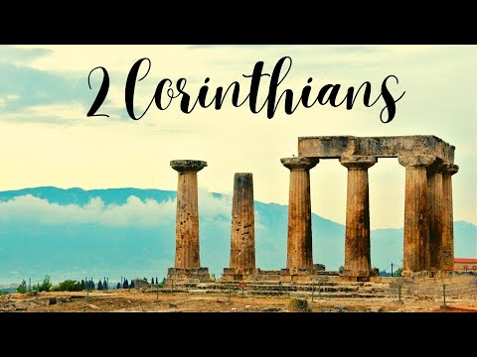
The Crucial Concerns of Ministry
Unraveling the Mystery of Suffering
Week 76
24 January 2024

Slide 2
2 Corinthians Introduction
AUTHOR: Paul of Tarsus, the Apostle to the Gentiles, wrote Second Corinthians on his third missionary journey just one year after his first letter to the Church in Corinth.
DATE AND PLACE OF WRITING: Second Corinthians was written in Philippi near the end of A.D. 56. Paul had just finished his three-year ministry in Ephesus and was visiting the churches in Macedonia on his way to Corinth.
While in Macedonia, Paul met Titus, who had returned from Corinth with a good report about the church which led Paul to write this letter.
KEY VERSES: 2 Corinthians 4:5; 9:7, and 10:8

Slide 3

2 Corinthians Introduction
CITY OF CORINTH:
Was a wealthy city because of its strategic geographical location, very diverse and pluralistic – multicultural, multiethnic society.
Was a locus of political power and a host to the surrounding regional governors.
Was a booming place of commerce, economic prosperity, and peace.
Many religions existed side-by-side, resulting in a plethora of syncretistic belief systems.
Boasted a larger marketplace and an institutional bank system.

Slide 4
2 Corinthians Introduction
CITY OF CORINTH:
Hosted the Isthmus games with included athletic and artistic competitions.
It was known for its numerous temples of various deities including the Temple of Aphrodite the goddess of Love.
It was known as the center of immorality, people came to Corinth on holiday to spend money and find pleasure.
Corinth stood for everything that was sinful, it became so notorious that the term “Corinthianize” came to mean “to live in debauchery,” the name “Corinth” became synonymous with immorality and decadence.

Slide 5
2 Corinthians Introduction
CHURCH AT CORINTH:
It was into this social environment that Paul, on his second missionary journey, established the church in Corinth and spent 18 months there preaching and teaching the gospel.
The church was plagued with schisms and factions, and sexual immorality.
Marital problems, lawsuits, misconduct during the Lord’s Supper were prevalent and the list could go on and on.
Yet, the church was known for its spiritual giftedness, including speaking in tongues and prophecy.

Slide 6
2 Corinthians Introduction
CHURCH AT CORINTH:
The Corinthians lived in a world much like our 21st century world.
They experienced the same thirst for intellectualism, the same permissiveness toward moral standards, and the same fascination for the spectacular.
The church in Corinth was like our churches: proud, affluent, materialistic, fervently eager for intellectual and social acceptance by the world.
They were doctrinally orthodox but morally and practically conforming to the world.

Slide 7
2 Corinthians Introduction
PURPOSE OF THE EPISTLE: Because many in Corinth did not like the corrections of the first letter. False teachers had persuaded them to challenge Paul’s apostolic authority. They claimed Paul was fickle, proud, unimpressive in appearance and speech, dishonest, and unqualified as an apostle of Jesus Christ.
So, in response to a potential mutiny in Corinth, Paul writes this letter as a treatise on authentic ministry. In this vivid picture of raw but real ministry, he shines a light on the inferior motives, methods, and messages of false teachers and ministries.
In this letter, Paul expresses his thanksgiving for the repentant majority, and appeals to the rebellious minority to accept his apostolic authority as authentically from Christ.

Slide 8
2 Corinthians Introduction
THEME OF EPISTLE: The themes of this letter revolve around both theological concepts and the practical aspects of Christian living, including crucial concerns of ministry, principles of generous giving, and recognition and submission to true apostolic authority.
Paul speak to their concerns about the new covenant, forgiveness, relationships, suffering, and giving, and he pushes back on challenges to his apostolic credentials and authority by the false teachers and critics.
In this pastoral letter, Paul’s objective is to provide guidance, encouragement, and correction to help the Corinthians navigate these issues that still challenge their unity, discipline, and spiritual growth.

Slide 9
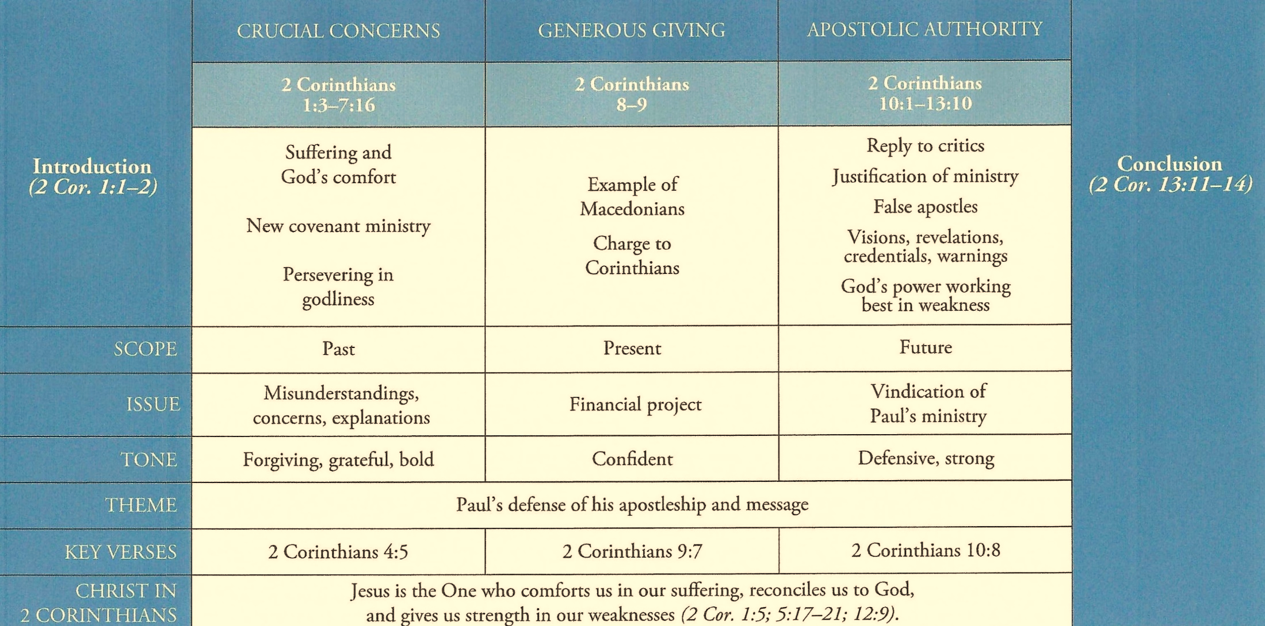
Purpose and Presentation
Second Corinthians
Authentic Ministry

Slide 10
2 Corinthians Overview
This second letter to the Corinthians consist of five sections, that focuses on the churches ongoing issues with spiritual immaturity, the brazing attacks on Paul’s authority, and the “Stuff of Authentic Ministry.”
In the first section, The Crucial Concerns of Ministry (1:1-3:18). Paul affirms God’s comfort in the midst of affliction. Defends the integrity of his ministry, addresses some urgent issues facing the church, and urges the church to preach and stand boldly for the gospel.
In the second section, The Ministry of Reconciliation (4:1-5:1). Paul declares that God uses earthen vessels fashioned from clay, and filled with His spirit to carry out the ministry of reconciliation.

Slide 11
2 Corinthians Overview
In the Third section, The Realistic Picture of Ministry (6:1-7:16). While describing the realistic hardships of ministry, Paul challenges the Corinthian Christians to a life of personal and corporate holiness.
In the Fourth section, The Self-Sacrificial Ministry (8:1-9:15). In this discussion on the principles of giving, Paul emphasizes the need to be a “cheerful giver” sacrificially giving resources, financial, and otherwise for ministry to others.
In the Fifth section, The True Apostolic Ministry (10:1-13:14). Paul defends the authenticity of his ministry as an apostle against those in the Corinthian church who had doubted and ridiculed his God-given authority.

Slide 12

Unraveling the Mystery of Suffering 1:1-11

Slide 13
2 Corinthians - Lesson Overview
Swindoll … opens this study by reminding us that poets and hymn writers have a way of piercing the darkness of our despair with brilliant rays of hope.
But often when we are over our heads in suffering or sorrow, words meant to comfort and console only frustrate and irritate.
When through fiery trials thy pathways shall lie, my grace, all sufficient, shall be thy supply; The flame shall not hurt thee; I only design thy dross to consume, and thy gold to refine.
The comforting words of “How Firm A Foundation!” But when the fiery trails threaten to reduce our lives to ashes, these words are not usually found in our heart or on our lips.

Slide 14
2 Corinthians - Lesson Overview
Those great Sunday morning words of worship don’t always make it out of the church and into the challenges of our lives.
When we minister to families who have lost a mother to cancer, or a child to a drunk driver, or a son to an overdose, or a daughter’s innocence to a sexual predator, somehow we don’t think of telling them about the gold being refined or the dross being consumed.
The family drowning in the pain of loss, so potent it is physical. If the words of “How Firm A Foundation” is not already planted deep in their hearts, a quick, desperate act of foundation repair, on our part, will not suddenly help them unravel the mystery of suffering.

Slide 15
2 Corinthians - Lesson Overview
Illness, marital struggles, worry over children, stress about finances, anxiety over the future: these things can tie our hearts and minds in knots and make it seem like life is interrogating us … Why God? Why me? Why now? Why this?
The loud, dissonant sounds of suffering make it almost impossible to hear God’s comforting anthem that could help us make sense of the seemingly senseless.
So Second Corinthians, composed by one who was no stranger to suffering, heartache and pain, one who bore the marks of shipwreck, stoning, a thorn in the flesh that wouldn’t leave. Paul’s soul knew the pain of being maligned and falsely accused, false rumors, misunderstanding and loss.

Slide 16
2 Corinthians - Lesson Overview
Paul lived with suffering, regularly facing it head on. These opening words state in simple terms his position, as best as he can explain it, regarding the pain, heartache, and suffering of life.

Slide 17
2 Corinthians 1:1-3
¹Paul, an apostle of Jesus Christ by the will of God, and Timothy our brother, To the church of God which is at Corinth, with all the saints who are in all Achaia: ²Grace to you and peace from God our Father and the Lord Jesus Christ. ³Blessed be the God and Father of our Lord Jesus Christ, the Father of mercies and God of all comfort,

Slide 18
2 Corinthians 1:1-3
Knowing how his authority had been pummeled by critics from both outside and inside the church, Paul in the opening words of this letter reminds his readers of his credentials.
He is “an apostle of Jesus Christ” not by his own choice but “by the will of God” (1:1).
What a sad state of affairs, that within just a few years of founding the church, they now doubt the authenticity of Paul’s ministry.
He also mentions Timothy as his “brother” who often served as Paul’s representative when he could not personally be in various locations.
Interestingly, Paul addresses this letter not just to the church at Corinth, but beyond that to “all the saints who are throughout Achaia” (1:1).

Slide 19
2 Corinthians 1:1-3
Paul may have extended its scope because the positive exhortations and the negative corrections applied broadly to issues and problems throughout the region.
Or, he may have feared that the apostolic pretenders meddling in Corinth would spread their cancer throughout the region.
With these formalities aside, Paul greets his beloved children in the faith warmly with his standard epistolary greeting, “Grace to you and peace from God our Father and the Lord Jesus Christ” (1:2).
Immediately, Paul begins the body of his letter with the word “Blessed” his praise to the Father and Jesus Christ.

Slide 20
2 Corinthians 1:1-3
Then as he praises God for both His mercies and His comfort (1:3), Paul quickly transitions to a discussion of pain, suffering, and heartache.
In highlighting God’s mercy, Paul reminds us that we are totally depraved sinners, in whom there is nothing good.
And a God who meters out justice should be pouring out His wrath upon us. Instead, God protect us from the full brunt of the pain and suffering we can expect from life.
God is “the Father of mercies,” not just for believers but even for unbelievers, many of whom experience even less suffering than believers.
God is also the source of “all comfort,” God comforts us in every “affliction.”

Slide 21
2 Corinthians 1:1-3
In verses 3-7, the same Greek root, for comfort “parakaleo,” is used ten times. The idea is one of bringing help, consolation, or comfort.
Like a nurse at a patience bedside, or a companion providing strength to a friend during weakness, “comfort” is given by those who care enough to reach out and help in times of need.
This is one of the words Jesus uses for the Holy Spirit: “I will ask the Father, and He will give you another Helper [Comforter], that he may be with you forever” (John 14:16).
Many of us imagine that the Holy Spirit comforts the suffering mystically, immediately, and directly – and that does happen occasionally.

Slide 22
2 Corinthians 1:1-3
Yet, at times in the midst of some tragedy, crisis, or catastrophe, a sudden, inexplicable peace passes over us.
From that moment on, we know, we believer, we even feel that God is in control and we can rest in Him regardless of the outcome.
More often, however, the Spirit works through Spirit-indwelled believers and the Spirit-filled community of faith to minister to those who suffer.
By an encouraging word, a heart-felt embrace, a kind note, a loving presence, a side-by-side walk through death’s valley – the spirit works through God’s people to comfort those downtrodden by the pain and turmoil of life.

Slide 23
2 Corinthians 1:1-3
Having assured the Corinthians that God comforts us, and that the Spirit ministers comfort in our lives, Paul takes a closer look at the reason why God allows suffering in the first place.
While the Bible gives no quick or easy answers to the problem of suffering, Paul touches on three ways God uses our suffering in this world for our good and His glory.
Swindoll … “I don’t want you to get the impression that these three things will answer the ultimate question of WHY?”
We must understand them as the redemptive work of an all-good, all-wise, all-powerful God who graciously and mercifully brings good from even the worst situations (Romans 8:28).

Slide 24
2 Corinthians 1:4-7
⁴who comforts us in all our tribulation, that we may be able to comfort those who are in any trouble, with the comfort with which we ourselves are comforted by God. ⁵For as the sufferings of Christ abound in us, so our consolation also abounds through Christ. ⁶Now if we are afflicted, it is for your consolation and salvation, which is effective for enduring the same sufferings which we also suffer. Or if we are comforted, it is for your consolation and salvation. ⁷And our hope for you is steadfast, because we know that as you are partakers of the sufferings, so also you will partake of the consolation.

Slide 25
2 Corinthians 1:4-7
FIRST – Suffering prepares us to comfort others (1:4-7). God’s grace and power enable us to endure suffering through various means.
When His comfort has done its work in our lives, then we in-turn become the Holy Spirit’s comforters for others who will endure similar situations.
The Lord can use our horrible experiences to minister to countless lives with the hope-filled, message of Christ.
The comfort of God through a tragic experience can explode into a chain reaction of comfort for others. The parent who has lost a child can best comfort another grieving parent. The businessman who suffered bankruptcy can comfort other in the throes of financial disaster.

Slide 26
2 Corinthians 1:4-7
Men and women who have endured the pain of chronic illness can best support those facing the same kind of suffering.
Those who have overcome the debilitating effects of depression can minister comfort to others who have been crippled by this insidious black hole in the soul.
Paul points out an important theological truth we would do well to keep at the forefront of our minds: Suffering is not a punishment, but a sharing in the “sufferings of Christ” (1:5).
Just as our Lord Jesus suffering in this world, so we who have committed to following in His footsteps should not expect to escape the same kind of suffering as our Master (Matt. 10:24).

Slide 27
2 Corinthians 1:4-7
Just as Christ conquered suffering and death through the resurrection, so also we will conquer being raised by the same Spirit (Rom. 8:11). While we have been called to a life of much suffering, God’s comfort will lessen that suffering.
Paul point out that he and his apostolic associates have been afflicted with trials, persecution, imprisonment, and hardships for the sake of the Corinthian Christians (1:6).
So, as the Corinthians themselves faced uncomfortable pressure from false teachers, Paul and the other authentic teachers were in a position to encourage them to persevere through suffering (1:7).

Slide 28
2 Corinthians 1:8-9
⁸For we do not want you to be ignorant, brethren, of our trouble which came to us in Asia: that we were burdened beyond measure, above strength, so that we despaired even of life. ⁹Yes, we had the sentence of death in ourselves, that we should not trust in ourselves but in God who raises the dead,

Slide 29
2 Corinthians 1:8-9
SECOND – Suffering keeps us from trusting ourselves (1:8-9). We don’t know what specific “affliction” or “danger,” Paul and his companions faced in Asia, but clearly is was extreme. “We were burdened beyond measure, above strength, so that we despair even of life” (1:8).
The Greek word for “despaired,” exaporéo implies “the total unavailability of an exit.” Paul found himself cornered by catastrophe, unable to extricate himself, with no where to turn and nobody to turn to.
When Paul saw himself on the brink of mortal demise, having “the sentence of death” in and of themselves, he discovered God second purpose in suffering: “that we would not trust in ourselves, but in God who raises the dead” (1:9).

Slide 30
2 Corinthians 1:8-9
Intense suffering reminds us of our utter helplessness – something we often forget when everything is going well.
However, Proverbs 3:5-6 says, “Trust in the Lord with all your heart and lean not on your own understanding; In all your ways acknowledge Him, and He shall direct your path.”
The world’s wisdom challenges this biblical truth. It urges us to follow our hearts, trust in ourselves, and find our own inner strength.
However, when the dire circumstance of life push us to the very edge of ourselves, we realize that we simply lack the knowledge, strength, and even desire to go on.
When worldly wisdom deceives us and personal resources run dry, God’s strength and wisdom provides us with everything we need to be comforted in our suffering.

Slide 31
2 Corinthians 1:10-11
¹⁰who delivered us from so great a death, and does deliver us; in whom we trust that He will still deliver us, ¹¹you also helping together in prayer for us, that thanks may be given by many persons on our behalf for the gift granted to us through many.

Slide 32
2 Corinthians 1:8-9
THIRD – Suffering teaches us to give thanks in everything (1:10-11). When God delivers us from hardship as a result of the faithful prayers of the saints, those prayer partners return praise and thanksgiving to God.
This in turn builds hope and trust in the God who has delivered us. So, as we encounter suffering and then conquer it through answered prayer, we automatically respond to God with thanksgiving.
Paul’s meditation on the mystery of suffering moves him from an attitude of despair (1:8), to a confession of faith and hope in God, his deliverer (1:10-11).
Because of God’s pattern of faithfulness to us and all the saints before us, we can have a spirit of gratitude – even in the midst of suffering.

Slide 33
2 Corinthians 1:8-9
Many people struggle with thanking and praising God in the midst of hardship, trials or suffering.
And many who resist this practice are struggling with bitterness, disappointment with God, and even doubts about His goodness.
We might think that if they only knew how this fit into God’s plan, they would be able to offer Him a token of thanks. But God never promises to explain the purpose of our suffering.
Rather, He promises only that perseverance will be worth it in the end and that He can always be trusted to do what is best for us.

Slide 34
Applications
Of the
lesson
Handling the Perplexities of Suffering

Slide 35
Application – handling the perplexities of suffering
In closing Swindoll repeats … three simple principles that sheds light on the mystery of suffering.
Suffering prepares us to comfort others.
Suffering keeps us from trusting ourselves.
Suffering teaches us to give thanks in everything.
Easy to understand. A cinch to remember. Simple to teach . . .
But easy to embrace in the midst of a trial? Not so fast! Some of the simplest truths are almost impossible to recall and apply to the realities of everyday life.
In the same way, some of the simplest commandments in Scripture are the most difficult to obey – love your neighbor as yourself; love the Lord your God with all that you are.

Slide 36
Application – handling the perplexities of suffering
So how do we live out these principles in our everyday lives?
I understand Paul’s statements, but how do we put these into action?
FIRST – When suffering hits you and doesn’t seem to want to let up, this may seem unnatural and may even offend your sensibilities. But instead of focusing on your present situation, think of some ways you might help someone else.
This refocus will sound a note of hope. Consider the compassion you will gain and the comfort you can give to others who will face the same kind of trail.
Broken people understand other people who are being broken. By pondering how your current pain might be able to minister to others, you will gain both a perspective on the present and a hope for the future.

Slide 37
Application – handling the perplexities of suffering
With this hope, offer your experience of suffering to God to use in His kingdom as He sees fit.
SECOND – Rather than fighting, surrender; rather than resisting, release. This will increase your faith. Remember, life is bigger than you can handle. Give it to God.
Stop trying to overcome your physical or emotional pain on your own.
As you open yourself up to the Lord’s comforting touch, He will flow into the dry, barren crevices of your life with the cool, sustaining, refreshing water of life.
With faith, surrender your self-sufficiency to God so that you may experience His supernatural comfort and concern.

Slide 38
Application – handling the perplexities of suffering
THIRD – Although becoming bitter and depressed can and will come naturally, give thanks instead. This will bring you peace. Even when being angry seems to make sense, promoting a spirit of thanksgiving will bring healing to your soul.
By focusing on the blessings you have rather than the hardships you must endure, your attitude of thankfulness will become infectious, providing a tremendous testimony for those who want to experience the kind of peace you have.
Hope, Faith, and Peace – turns the otherwise discordant sounds of suffering into a harmonious chord. They may not answer all of the problems or unravel the mystery of pain in every respect, but they equip us with a new perspective from which to handle the perplexities of suffering.

Slide 39


“Unraveling the Mystery of Suffering”

Slide 40
NEXT CLASS – 31 January 2024
Book of Second Corinthians
Before next class, read the below chapters in the NKJV and in one other versions of the Bible, i.e., KJV, NRSV, NIV, CEV, etc …
Chapter 1:12 – 2:4
“In Defense of Integrity”

